Slide 1
Party of One
Luisa F. Canon Troy DuFrene Heather Garnos Evelyn Gould
Kate Kellum Emily Sandoz

Slide 3
Introductions

Slide 4
Disclosures
Luisa F. Canon
Relevant Financial Relationships:
Private clinician and Consultant
Founder & Research and Development Director, Institute for Effective Behavioral Interventions
Clinical Director, ACT to Thrive: Behavioral Consultation and Psychological Services.
Relevant Nonfinancial Relationships
President Southern California Chapter of the Association for Contextual Behavioral Sciences.
Member at large for the Women in ACBS SIG board

Slide 5
Disclosures
Troy DuFrene
Relevant Financial Relationships:
Author receiving royalties from New Harbinger Publications
Private clinician and consultant
Relevant Nonfinancial Relationships
Co-Chair of CBA SIG, ACBS
Student editorial board member, JCBS

Slide 6
Disclosures:
Heather Garnos
Relevant Financial Relationships:
Employed by New Harbinger Publications
Relevant Nonfinancial Relationships
Student at Western Connecticut State University

Slide 7
Disclosures:
Evelyn Gould
Relevant Financial Relationships:
Clinical and Research Associate at McLean Hospital and Harvard Medical School
Private practice at New England Center for OCD and Anxiety, and Consultant for First Steps for Kids, Inc.
Relevant Nonfinancial Relationships
Associate Editor for Journal of Contextual Behavioral Science
Member of CBS Research Task Force for ACBS
Manager of the ABAI ACT and psychological flexibility SIG

Slide 8
Disclosures:
Karen Kate Kellum
Relevant Financial Relationships:
Employed by the University of Mississippi
Private Consulting for Institutional Effectiveness
Relevant Nonfinancial Relationships
Editorial Board for Journal of Contextual Behavioral Science

Slide 9
Disclosures
Emily Sandoz
Relevant Financial Relationships:
Private clinician, consultant, and trainer
Faculty and graduate coordinator at UL Lafayette
Author receiving royalties from New Harbinger publications
Relevant Nonfinancial Relationships
Associate Editor of Journal of Contextual Behavioral Science
Co-Chair of CBA SIG, ACBS

Slide 10
Notes:
What we have planned - whirlwind of somd Didactic with multiple opportunities to practice in groups. We hope to get the groups stable -- so if you plan to pop and in out, please let Heather know in the chat

Slide 11
Notes:
EMILY’s Part about Functional Contextual Logic fits well with Time Series Design / single subject …

Slide 12
Notes:
Of course, the relationship between behavior and context is constantly flowing –
humans are engaging in LOTS of behavior, and there are lots of influences on the flow of these

Slide 13
Notes:
And, at least while we’re learning to look, we’ll need to focus in a bit ….

Slide 14
Notes:
The first step is to pick a behaving organism -- are you the behaving organism, is this… your client, your client’s child, the couple’s relationship ??/

Slide 15
Notes:
The second step is to pick a behavior or two – yes, your behaving organism is doing LOTS of stuff

Slide 16
Notes:
You can pick behavior based on its _form_ (aka topography) … or its _function.
Frankly, while we’re learning – form is easier. But, in the long run, function might be more important - as behavior and the context are constantly changing.

Slide 17
Notes:
By function – at it’s essence we are talking about
Behavior that is under appetitive control
And behavior that is under aversive control

Slide 18
Observable
Measurable
Repeatable
Notes:
Either way – whatever you are looking for needs to be defined … such definitions need to be …

Slide 19
Frequency, Intensity, Duration, Latency, Inter-response Time …
Notes:
Lots of things we could measure ----- but likely will be a count of how much it happens, how long it happens, how long it takes to happen, or it’s force/intensity

Slide 20
Too much
Not enough
Notes:
So people do stuff too much … and not enough …
While we’re getting started, it’s likely better to focus on stuff that only _behaving_ organisms can do .. That is, although it is easy to see stuff that people SHOULD NOT do … it’s better to focus on increasing behaviors.

Slide 21
“Teddy bear test”
Notes:
At the very least, don’t focus on things a dead person or inanimate object does really well.

Slide 22
Notes:
Let’s try out our lens

Slide 23
Hannah
“I just keep thinking…what if I’m missing something? What if I’m not doing enough?”
Notes:
GROUP EXAMPLE
Hannah was a 37-year-old Caucasian – Hispanic married mother of a 4-year-old boy named Sam. Sam suffers from severe food and environmental allergies, and has a history of hospitalizations and intensive medical treatment. Hannah had completed college-level education (bachelor’s degree) and was caring her child full-time at home, with her husband being the sole provider for the family.
Hannah has a history of anxiety and depression, reports feeling overwhelmed at home. She reports that her husband typically does not assist with childcare tasks and she never relies on others to help care for her child. She has friends and extended family members
who she feels she can count on for emotional support and typically spends approximately 5-10 hours per week interacting with friends or family members over the phone.
Hannah reports that all areas of her life have been highly impacted by the coordination of care for her child. She feels that she is doing her best caring for her child but that it isn’t sustainable to continue caring for him at this level alone. She expressed that she most struggles with the grief of her son’s medical diagnoses and the worry that there might be other therapies or treatment options for him out there that she did not know about - she has a constant feeling of “not doing enough” and struggles with guilt around whether she is doing enough to help him. The only time she can ever really relax is when Sam is asleep.
Hannah expressed that she would most like help with accepting that she is doing the best she can and can’t control everything. She also expresses that she would like a more balanced parenting partnership with her husband – to be able to stop “micromanaging” everything and to take time for herself to mentally disconnect for a while, and to see that as being “ok and healthy”.

Slide 24
Theresa
“Venting makes me feel better”
Notes:
SMALL GROUP CASE
Theresa is a clinical supervisee – she reports feeling burned out and is considering leaving the training program. She is struggling with setting boundaries with a family who often request changes to session times and frequency and the treatment plan, and do not accept recommendations or feedback from the supervisee. Your supervisee says “venting” makes her feel better but she goes home feeling very stressed every day and doesn’t have any “bandwidth” left for other clients. She spends a few hours a day venting to other coworkers at the clinic (as well as to her own family and friends), and this family have become the “hot topic” of the office the past few months.

Slide 25
Sinead
“I just want to be a kid forever”
Notes:
Sinead
Sinead is a 15yr old girl with OCD centering around a fear of getting older. She struggles with thoughts about growing up and wants “to be a kid forever”. She expressed she is scared of what it would be like to be an adult because people treat you differently and expect things of you. She has fears about adulthood being “boring” and “scary”.
Sinead struggles with a wide variety of compulsions and avoidance behaviors, including always telling people she’s younger than she is, always wearing her hair and clothes in styles she associates with being a kid, walking hunched over (to make herself small) and acting younger than her age. She is afraid to sweat (because she equates that with being a teen) and avoids any activity that might cause her to perspire. She avoids looking at or coming into contact with any items that she considers “adult” (e.g., razors, sports bras, deodorant, teen magazines, makeup etc.) She also only uses “kid products”, such as kids shampoo and toothpaste. She avoids talking about anything “teen” or “adult” as she believes that talking about these things will make her grow up faster.
At home, Sinead struggles with periods of extreme rage (yelling at family members, slamming doors, throwing objects, screaming) followed by depression and hopelessness. Sinead also struggles with perfectionism and expresses a constant desire to be a “good kid” and “do things right” – at school and at home. She asks constant reassurance questions from her parents, such as “Am I a good kid?”
All of these difficulties have led to school refusal for the past year and Sinead giving up most of the things she loves (including going to the barn to care for and ride her horse). She no longer sees her friends and struggles to leave the house for fear of coming into contact with any triggers. Her relationships with her family are difficult. She is particularly distant from her older sister, whom she previously had a good relationship with.
Sinead is motivated to be in treatment and wants to work towards a life that is not dominated by fear. She wants to go back to school and be able to play sports again like basketball, make friends, and be free to wear whatever she wants and wear makeup. She wants to be able to do all the things she loves without being restricted by OCD. Sinead loves to laugh and be goofy, and is an energetic and adventurous young woman - one day she would like to do “adult” activities like bungee jumping and skydiving.

Slide 26
ASD kids group
”We just want them to be happy”
Notes:
You are working with a small group of 7-10 year olds with high functioning autism struggling with difficulties related to inflexibility in play with peers at school, lack of social initiations, and poor responding to social cues. These difficulties often result in frequent negative interactions with peers and isolation during lunchtime and recess. The children will be coming to your center once per week for 2 hours, to participate in a social skills group. You are planning on running an ACT (DNAV) social skills group. Each child will have their own coach during the course of the social skills program. All children express a desire to participate in the group and say they want to have fun and to have friends, and not get upset at school. Their parents ”just want them to be happy” and worry about them being isolated and left out at school.

Slide 27
Designs

Slide 28
Was there a change in behavior (effect)?
Was it due to what you think you did (control)?
Notes:
All time-series designs aim to answer two questions:
Did the behavior change (or maintain)?
What it in a functional relationship with what you did?
That is, is your treatment working – can you turn on and off the stream

Slide 29
Within Series
Between Series
Combined-series elements
Notes:
Three primary types of N1 designs …that is what comparisons need to be made to determine effect and control..
Information about effect & control derived from examination “within a series of data points organized across time”
Differences level & trend at phase changes
In the context of variability of the data series
Aka - ABAB, Reversals, Changing Criterion Designs, parametric designs, periodic treatment design,

Slide 30
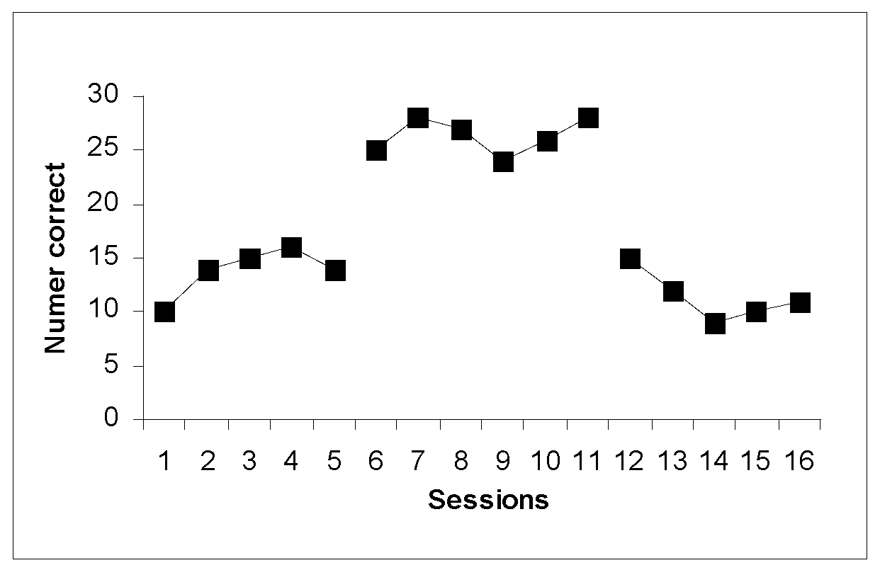
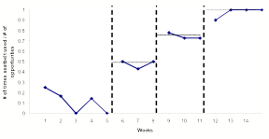
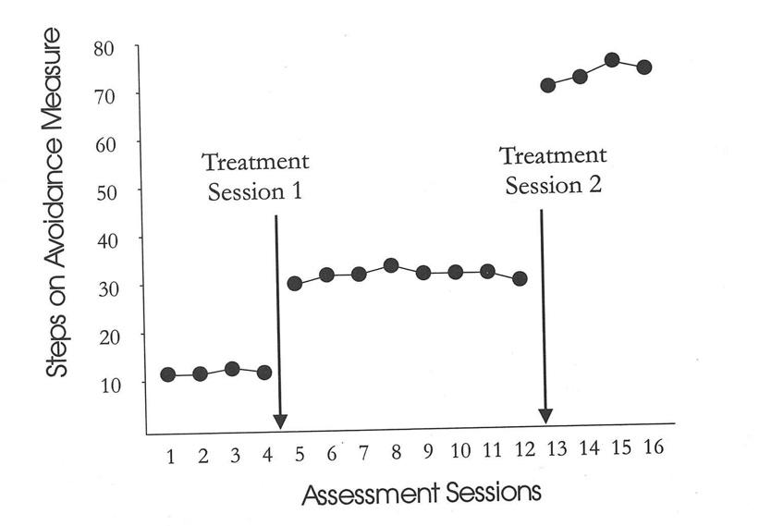
Within Elements….
Notes:
Effects of coincidental variability are minimized - examined in the context of measurement error & background variability

Slide 31
Within Elements….
Notes:
Effects of coincidental variability are minimized - examined in the context of measurement error & background variability

Slide 32
ABA (withdrawal or reversal)
Baseline
Intervention
Baseline

Slide 33
Changing Criterion Design
Level 3
Level 2
Level 1

Slide 34
Periodic

Slide 35
Parametric

Slide 36
Within Series
Between Series
Combined-series elements
Notes:
Information about effect & control derived from examination “between two or more series of data points organized across time”
Alternating Treatments, simultaneous

Slide 37
Alternating Treatments Design (one behavior)
Intervention 1
Intervention 2

Slide 38
Between Series Elements
Notes:
ATD - rapid random alternation of two or more conditions (Mixed or Mult schedules)
How show effect/Control
Cool stuff:
Order effects are less likely because of the rapid/random alternation - the order is highly variable….
No withdrawal is necessary
Rapid conclusions
Don’t have to have a baseline
STD - concurrent schedule

Slide 39
Within Series
Between Series
Combined-series elements
Notes:
Information about effect & control derived from examining both within and between data series
Differences in level & trend both between data series and at phase changes
In the context of variability within each data series
Multiple Baseline
Crossover design
Constant series Control
Reversal
Parallel Treatments Design

Slide 41
Notes:
Let’s Try it out

Slide 42
Hannah
“I just keep thinking…what if I’m missing something? What if I’m not doing enough?”
Notes:
GROUP EXAMPLE
Hannah was a 37-year-old Caucasian – Hispanic married mother of a 4-year-old boy named Sam. Sam suffers from severe food and environmental allergies, and has a history of hospitalizations and intensive medical treatment. Hannah had completed college-level education (bachelor’s degree) and was caring her child full-time at home, with her husband being the sole provider for the family.
Hannah has a history of anxiety and depression, reports feeling overwhelmed at home. She reports that her husband typically does not assist with childcare tasks and she never relies on others to help care for her child. She has friends and extended family members
who she feels she can count on for emotional support and typically spends approximately 5-10 hours per week interacting with friends or family members over the phone.
Hannah reports that all areas of her life have been highly impacted by the coordination of care for her child. She feels that she is doing her best caring for her child but that it isn’t sustainable to continue caring for him at this level alone. She expressed that she most struggles with the grief of her son’s medical diagnoses and the worry that there might be other therapies or treatment options for him out there that she did not know about - she has a constant feeling of “not doing enough” and struggles with guilt around whether she is doing enough to help him. The only time she can ever really relax is when Sam is asleep.
Hannah expressed that she would most like help with accepting that she is doing the best she can and can’t control everything. She also expresses that she would like a more balanced parenting partnership with her husband – to be able to stop “micromanaging” everything and to take time for herself to mentally disconnect for a while, and to see that as being “ok and healthy”.

Slide 43
Theresa
“Venting makes me feel better”
Notes:
SMALL GROUP CASE
Theresa is a clinical supervisee – she reports feeling burned out and is considering leaving the training program. She is struggling with setting boundaries with a family who often request changes to session times and frequency and the treatment plan, and do not accept recommendations or feedback from the supervisee. Your supervisee says “venting” makes her feel better but she goes home feeling very stressed every day and doesn’t have any “bandwidth” left for other clients. She spends a few hours a day venting to other coworkers at the clinic (as well as to her own family and friends), and this family have become the “hot topic” of the office the past few months.

Slide 44
Sinead
“I just want to be a kid forever”
Notes:
Sinead
Sinead is a 15yr old girl with OCD centering around a fear of getting older. She struggles with thoughts about growing up and wants “to be a kid forever”. She expressed she is scared of what it would be like to be an adult because people treat you differently and expect things of you. She has fears about adulthood being “boring” and “scary”.
Sinead struggles with a wide variety of compulsions and avoidance behaviors, including always telling people she’s younger than she is, always wearing her hair and clothes in styles she associates with being a kid, walking hunched over (to make herself small) and acting younger than her age. She is afraid to sweat (because she equates that with being a teen) and avoids any activity that might cause her to perspire. She avoids looking at or coming into contact with any items that she considers “adult” (e.g., razors, sports bras, deodorant, teen magazines, makeup etc.) She also only uses “kid products”, such as kids shampoo and toothpaste. She avoids talking about anything “teen” or “adult” as she believes that talking about these things will make her grow up faster.
At home, Sinead struggles with periods of extreme rage (yelling at family members, slamming doors, throwing objects, screaming) followed by depression and hopelessness. Sinead also struggles with perfectionism and expresses a constant desire to be a “good kid” and “do things right” – at school and at home. She asks constant reassurance questions from her parents, such as “Am I a good kid?”
All of these difficulties have led to school refusal for the past year and Sinead giving up most of the things she loves (including going to the barn to care for and ride her horse). She no longer sees her friends and struggles to leave the house for fear of coming into contact with any triggers. Her relationships with her family are difficult. She is particularly distant from her older sister, whom she previously had a good relationship with.
Sinead is motivated to be in treatment and wants to work towards a life that is not dominated by fear. She wants to go back to school and be able to play sports again like basketball, make friends, and be free to wear whatever she wants and wear makeup. She wants to be able to do all the things she loves without being restricted by OCD. Sinead loves to laugh and be goofy, and is an energetic and adventurous young woman - one day she would like to do “adult” activities like bungee jumping and skydiving.

Slide 45
ASD kids group
”We just want them to be happy”
Notes:
You are working with a small group of 7-10 year olds with high functioning autism struggling with difficulties related to inflexibility in play with peers at school, lack of social initiations, and poor responding to social cues. These difficulties often result in frequent negative interactions with peers and isolation during lunchtime and recess. The children will be coming to your center once per week for 2 hours, to participate in a social skills group. You are planning on running an ACT (DNAV) social skills group. Each child will have their own coach during the course of the social skills program. All children express a desire to participate in the group and say they want to have fun and to have friends, and not get upset at school. Their parents ”just want them to be happy” and worry about them being isolated and left out at school.

Slide 48
Data Evaluation
Data Analysis
Notes:
Now we have all of our SCED data. What the hell do we do with it?
The first thing to note is that we’re going to be considered with with two evaluative criteria: the experimental and the therapeutic:
The experimental criterion refers to judgments about whether behavior change has occurred and whether the change can be attrib­uted to the intervention. The therapeutic criterion refers to whether the effects of the intervention are important or of clinical or applied significance.

Slide 49
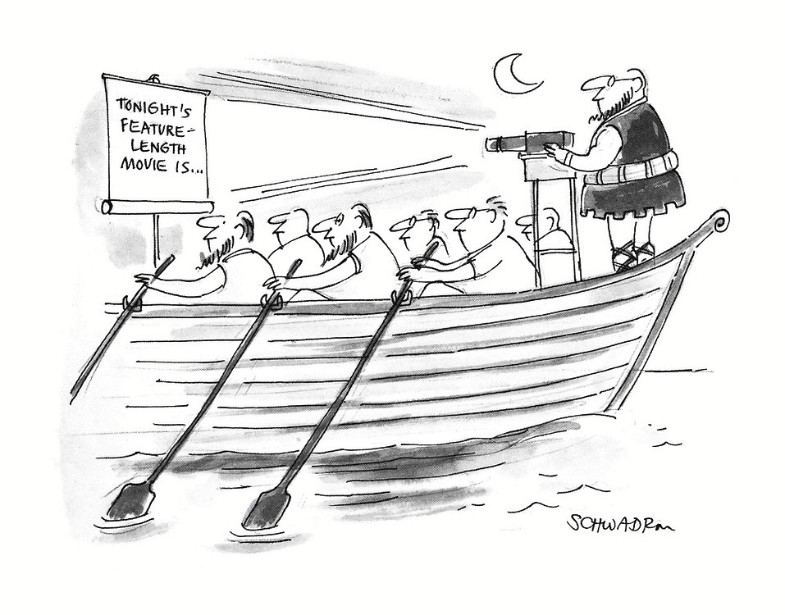

Slide 50
Visual vs. Statistical Evaluation
Most common evaluation for SCEDs (from widespread use in experimental analysis of behavior)
Unrefined and insensitive
A good thing
Restricts agreement that the intervention produced a change
Serves to filter less markedly effective treatments
Most common in traditional psychological research
Familiar to researchers
Much more sensitive than visual inspection
An effect can be very small yet still statistically significant
Notes:
Systematic investigation of the single subject began in laboratory research with nonhuman subjects. The careful control afforded by laboratory conditions helped to meet major requirements of the design, including minimal variability and stable rates of performance. Potent variables were examined (e.g., sched­ules of reinforcement) with effects that could be easily detected against the highly stable baseline levels. The lawfulness and regularity of behavior in rela­tion to selected variables obviated the need for statistical tests.
But as SCED was extended to humans, human complexity entered the equation. More complex patterns were observed, more confounds were identified in data, and baseline stability did not follow nonhuman patterns. Visual inspection was often not possible for these more complex experiments.

Slide 51
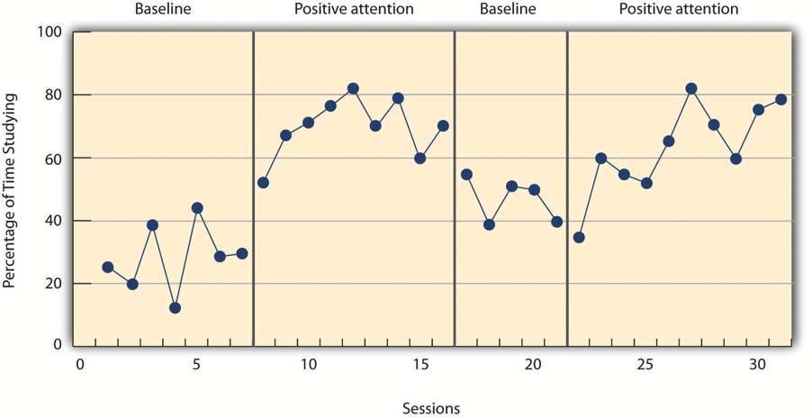
Single-case experiment
1 mariner is forced to serve aboard a ship canoe, rowing.
baseline
movies
baseline
movies
-------------
-------------
Strokes per minute
-------
-------------
Voyages

Slide 52
Large n, between-group experiment
(N^{e}) mariners forced to serve aboard a ship who ARE shown movies while being forced to row
(N^{c}) mariners forced to serve aboard a ship who ARE NOT shown movies while being forced to row
#^{e}
#^{c}
Is the difference significant?
t, f, r, etc. + p < 0.05
What is the effect size?
d, η_{p}², etc.
“A one-way ANOVA was conducted to compare the effect of showing movies on the number of stroke per minute rowed by conscripted mariners. A significant effect was observed between the control (M = 8.4, SD = .9) and experimental groups (M = 10.8, SD = 1.1): F(2,66) = 99.82, p < .01. The effect size was medium: η_{p}² = 0.06.”

Slide 53
changes in LEVEL
baseline
movies
baseline
movies
-------------
-------------
Strokes per minute
-------
-------------
Voyages
changes in MEAN
Notes:
There are several aspects to visual interpretation:
Changes in MEAN across phases refer to shifts in the average rate of performance
Changes in LEVEL refer to the shift or discontinuity of perfor­mance from the end of one phase to the beginning of the next phase. A change in level is independent of the change in mean
In this admittedly fake example, changes in mean and level occur in each phase, buy this need not be so.

Slide 54
changes in LATENCY
baseline
movies
baseline
movies
-------------
-------------
changes in TREND
Strokes per minute
-------
-------------
Voyages
Notes:
Changes in TREND Trend or slope refer to the tendency for the data to show systematic increases or decreases over time
Changes in LATENCY refer to refers to the period between the onset or termination of one condition (e.g., intervention, return to baseline) and changes in performance. The more closely in time that the change occurs after the experimental conditions have been altered, the clearer the intervention effect. . As a general rule, the shorter the period between the initiation of the intervention and observed behavior change, the easier it is to infer that it was actually the treatment that led to change. The rationale is that as the time between the intervention and behavior increases, the more likely that confounding influ­ences may have accounted for behavior change.
In practice, changes in mean, level, and trend, and latency of change go together, thereby making visual inspection more easy to invoke than one might expect. For example, data across phases may not overlap. Nonoverlapping data refers to the finding that the values of the data points during the baseline phase do not approach any of the values of the data points attained during the inter­vention phase.

Slide 55
Pros and Cons of Visual Inspection
PRO
When effects are strong, the need for more complicated statistical analysis is eliminated
Results are easily interpretable by a wide range of interested parties
Encourages researchers to seek and prefer strong interventions
CON
Lack of concrete decision-making rules about effects
Multiple studies have shown that experts often disagree on whether effects have been clearly demonstrated
Has the potential to ignore meaningful yet subtle effects of treatment
Requires particular patterns of data to be useable at all
Notes:
If anyone is familiar with Neil Jacobson’s

Slide 56
Pros and Cons of Statistical Analysis
PRO
Once determined, decision-making criteria tend to be consistent across researchers
Statistical tests can detect more subtle effects
Normality assumptions bring many advantages to parametric testing procedures
Effect-size calculation makes meta-analysis possible
CON
Often detects and judges significant results that would fail visual inspection methods
Statistically significant results may identify effects that are not clinically significant
Lack of analytic techniques
Since statistical analysis is less common for SCED results, statisticians think less about appropriate analysis strategies for SCED, and so the development of these strategies has lagged

Slide 57
Indications for Statistical Analysis
Unstable baselines
New research areas
Increased variability within subjects
Small changes can be important
Notes:
Visual inspection requires stable baselines, but statistical analysis can take the initial trend into consideration, so having stable baselines is less of a problem.
Newer interventions tend to be weaker, until the bugs are worked out. When researching newer approaches, the results may not be clear enough to permit visual inspection. In these cases, statistical analysis may reveal subtler effects that can be capitalized on over time to improve interventions.
In research settings where there is less chance for tight experimental control, factors external to the experiment may increase subject response variability. For these cases, statistical tests can be useful to determine if the intervention leads to reliable change.

Slide 58
Tests for SCED
t and F tests
Conventional assumptions must be met
Data cannot show serial dependence
Dead-easy analysis
Time-series analysis
Deals with serial dependence
Separate t or F tests for level and trend
Requires long-ish studies
Randomization tests
Requires a high number of data samples at different time points AND pre-randomization
Ranking tests
Split-middle techniques
And more...

Slide 59
Meta-Analysis of Single-Case Designs (MASCD)
Far more recent development than statistical analysis in general
Shadish 2008, 2014
Relies on effect-size calculation to compare methodologically dissimilar studies
Parametric and non-parametric effect size estimates
Each has advantages and disadvantages
SPSS macros and R scripts are widely available

Slide 60
Resources
https://tinyurl.com/SCED2020

